Slide 1
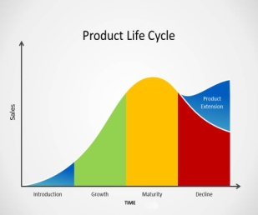
Unit 2: Marketing Knowledge Organiser
2:1 The Role of Marketing
2:2 Market Research
Target market
The group of customers who a business aims to sell its products to
Primary research
Data collected first-hand (field research)
Secondary research
Data collected by others (desk research)
Qualitative data
Data based on opinions of those being asked
Quantitative data
Data based on facts or numbers
Marketing is:
finding the needs of customers and demonstrating how a business fulfils those needs in order to increase sales
How can a business increase sales?
Advertise the product or service more in order to raise awareness of what is on offer
2. Introducing a new model that will appeal to more customers
3. Increase the range of products or services available
4. Reducing the price to sell more products - but will profits increase?
5. Selling the product in different countries to target a wider range of customers
6. Selling by different methods i.e. Online or offering digital distribution
Before a business starts, it is important that the owners know exactly who their customers are likely to be.
Primary | Pros | Cons
Questionnaire | Cheaper than interviews Easily target certain people | Difficult to predict how many will be completed people may not understand the questions
Interviews | Questions can be explained Customers can be easily targeted | Expensive Customers may feel uncomfortable
Trials | Save money before making products widely available | Costly to set up
Focus groups | Data is accurate to the target market | Only small groups that take part so expensive
Marketing
Finding the needs of consumers and demonstrating how a business meets those needs
Market research
The collection of data to help business decisions
Secondary sources include census data, websites, internal data and newspapers.
Pros: cheap and already available to use
Cons: not exactly what you need and could be out of date
A watch can be segmented in a number of ways:
Age - Disney theme for children, plain for adults
Gender - made for men or women
Income - watches can be very cheap at £10 others can be very expensive at £1000’s
Lifestyle - special watches for diving, running and other outdoor sports
2:3 Market Segmentation
2:4 The Marketing Mix - Product
Market segments
Location
Lifestyle
Income
Age
Gender
The product is a vital element of the marketing mix. The product or service must be something customers actually want.
Advertising a new product more widely can increase sales and extend the life of a product.
Introduction
A product is first made available for sale
Growth
Sales are growing strongly
Maturity
Sales are at their highest level
Decline
Sales are falling
Reducing the price of a product can help to maintain sales and extend the life of a product.
Market segmentation
Splitting the market for a product into different parts, or segments
Selling in new markets i.e. abroad, opens the product up to a wider range of new customers and so extends the life of the product

Slide 2
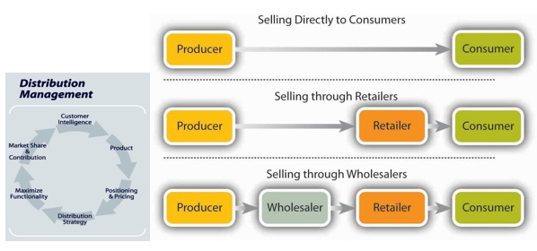
Unit 2: Marketing Knowledge Organiser
Competitor pricing
A price is set based on prices charged by competitors
Cost-plus pricing
Adding a percentage of profit onto the total costs of making a product
Penetration pricing
A price is set lower than competitors
Skimming
A high price is charged initially for those customers who want the latest products
Promotional pricing
Prices are reduced to give sales a boost
2:4 The Marketing Mix - Price
Place is:
concerned with where the product is sold from and the distribution of goods
2:4 The Marketing Mix - Place
A business must take great care when setting the price of products and services. Too low and the business won't make enough profit, too high and customers will not buy
Factors affecting the price
The business. If new, customers may not know the name and will be reluctant to pay high prices
The price charged by other businesses
The costs to produce the product or service
The income of the target market
Physical distribution
Distribution of goods using a physical presence
Digital distribution
Distribution of goods and services digitally by downloading from a website
Advantages of digital distribution | Disadvantages of digital distribution
Customers can access products and services 24/7 Goods are downloaded so available quickly No physical product to deliver so the business saves money | Not all goods are suitable for digital distribution i.e. bread Not all customers have access to the internet Easier for illegal content to be copied and distributed which means the business loses sales
Aims of promotion
To inform customers about a product or service To keep a business ahead of its competitors To create or change the image of a business, its products and services To maintain or increase sales
2:4 The Marketing Mix - Promotion
Assessment Information
Possible questions
Identify which price a business should charge.
Explain one advantage and one disadvantage of using focus groups.
Analyse one benefit of a businesses distribution channel.
Analyse two benefits of using questionnaires to gather market research.
Evaluate whether or not a business should use social media to promote its products.
Advertising media
Radio
Websites
Printed media
TV
Social media
Your assessment will take place during a normal timetabled lesson but you should be revising at home.
Number of marks available: 40
Time allowed: 50 minutes
Answer ALL of the questions
The first 10 questions will be multiple choice - you must only select ONE answer, selecting two will score 0 marks.
The other questions will include a range of 2, 3, 4, 6, 7, & 9 mark questions
Point of sale promotions
Price reductions, loss leaders, competitions, free samples
Advertising campaign
A series of advertisements often using different advertising media
Advertising media
The methods by which a business can advertise a product
State Explain Analyse Recommend Evaluate

