Slide 1

Notes:
This is a presentation on behalf of the Department for Education to talk to you about higher education student finance in England.
The main aim is to discuss the financial support package available from government for higher education, both tuition fees and your general living costs.
Finance is a big consideration when you’re considering higher education, and it’s important to understand the costs involved: tuition fees, rent and money to help you live are all very important.
Everyone’s circumstances are different when choosing whether to go to University, and sometimes you need help in making the decision on whether to go or not.

Slide 2
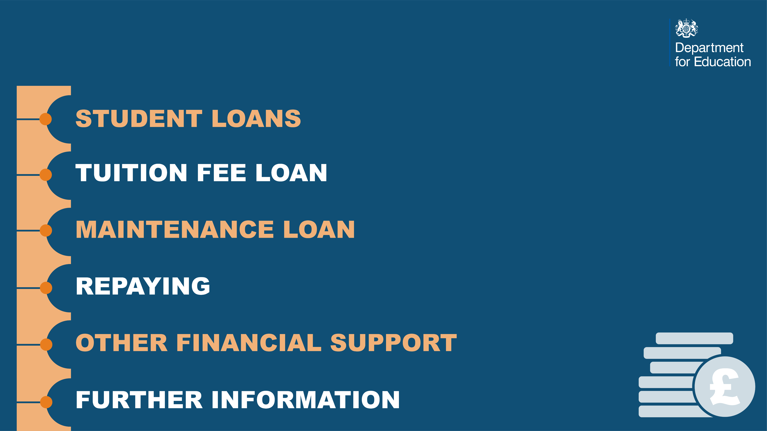
This slide pack covers…

Slide 3

What are Student Loans?
Funds loaned to you by the government, to help you cover the costs of going to university.
There are two types of loan:
A Tuition Fee Loan - paid to your university to cover the costs of your tuition
A Maintenance Loan - paid to you to help with living costs - like rent, bills, books and socialising
These loans are very different to commercial loans offered by banks. They are designed to make sure your repayments don’t start until a year after you’ve graduated, and are always manageable and affordable.

Slide 4


Slide 5

What is a Tuition Fee Loan?
A Tuition Fee Loan is there to cover the costs of your tuition.
It’s paid directly to your university or college, in three instalments per year.
If you attend a publicly-funded university or college and it’s your first degree (it is for the vast majority of students) you will be eligible for a loan that covers all of your tuition fees

Slide 6
What do Tuition Fees cost?
The Government sets maximum fee levels for universities and colleges that are publicly funded. The highest amount a publicly-funded university or college in England can currently charge is £9,250 for a full-time course.
Some Higher Education institutions have lower maximum fee levels, depending on whether they meet certain legal requirements. To find out more contact the uni or college you’re interested in studying at.
The important thing to remember is that you will be able to access a tuition fee loan to cover the full amount of your fees at publicly-funded providers.

Slide 7
What do Tuition Fees cost – at private providers?
There are some private higher education providers in the UK. Their maximum fee levels aren’t capped by the government.
If you choose to go to a private provider you will be able to apply for up to £6,165 towards your fees.
This could mean you're not able to borrow the full cost of your tuition fees, as private universities can charge whatever fee they want…So you will need to do your homework!
You can find out on the internet if a uni or college is private.

Slide 8
How do Student Loans work?
Once you’ve decided to study a higher education course, you can apply for a Tuition Fee Loan of up to £9,250 per year to cover the cost of your course fees.
You apply through Student Finance England and the money is paid directly to your chosen university or college, so you don’t need to worry about making any payments yourself.
You won’t need to pay anything back –
  Until you've left university or college
    and
  Until you start earning over £25,000 per year.

Slide 9


Slide 10

Rent, books, food and socialising are all a big part of university life - and they all cost money.
The government also provides a maintenance – or living costs - loan that is designed to help towards your living costs.
The amount of support you can access for living costs depends on your circumstances, including your household income and where you live and study.
Once you have applied for the loan, it’s paid into your bank account in three instalments - then it’s up to you to plan your budget and be smart about spending!

Slide 11
How much support could you be entitled to?
The Maintenance Loan available to eligible students for the last academic year (2018/2019) was:
  Up to £7,324 for students living with your parents
  Up to £8,700 for students living away from home and studying outside London
  Up to £11,354 for students living away from home and studying in London – as it’s more expensive to study and live in London because of the higher cost of living
  If you’re doing a course that involved overseas study as part of UK based course, the maximum loan is £9,963.

Slide 12
Working out what you’re entitled to in 2019 / 20
There’s a table on the next slide to use as a guide, but you can also see how much you are eligible for at gov.uk/student-finance-calculator
Earlier this year, the Government introduced living costs support for eligible part-time students. These loans are similar to the support already available for full-time study. They’re available for some part-time higher education courses from 2019 onwards.
The amount available for Maintenance Loans in 2019/20 will be published on gov.uk as soon as they are available (they need to be approved by Parliament first).

Slide 13
MAINTENANCE LOAN SUPPORT FOR 2018/19
HOUSEHOLD INCOME | LIVING WITH PARENTS (£) | LIVE AWAY FROM HOME AND STUDYING OUTSIDE LONDON (£) | LIVE AWAY FROM HOME AND STUDYING IN LONDON (£)
£25,000 or less | 7,324 | 8,700 | 11,354
£30,000 | 6,707 | 8,076 | 10,719
£35,000 | 6,090 | 7,452 | 10,084
£40,000 | 5,473 | 6,828 | 9,449
£42,875 | 5,118 | 6,469 | 9,083
£45,000 | 4,885 | 6,204 | 8,813
£50,000 | 4,238 | 5,579 | 8,178
£55,000 | 3,621 | 4,955 | 7,543
£58,212 | 3,224 | 4,331 | 6,907
£60,000 | 3,224 | 4,054 | 6,272
£65,000 | 3,224 | 4,054 | 5,654

Slide 14


Slide 15

When do you start repaying your loan?
So, you’ve sorted out your tuition fee and maintenance loan - but how will you repay them? And when?
Good news! You will only be required to start making any repayments
From the April after you’ve graduated - and
If you’re earning above the threshold of £25,000 per year - and
You only ever repay a percentage of what you earn above that threshold
Your Tuition Fee Loan and Maintenance Loan are combined for repayment purposes, to keep it simple. And the student finance system is designed to ensure your repayments are always affordable.

Slide 16
How much will you pay back?
Once you’re earning over the £25,000 threshold:
You’ll pay 9% of anything you earn above that £25,000 per year.
Your employer will deduct this from your salary automatically, like taxes.
So, let's say your salary is £27,000 a year - you'll pay 9% of £2,000.
That’s just £15 pounds a month.
If you're self-employed, you’ll make repayments as part of your self-assessment return to HMRC, in the same way you’d pay self-employed taxes.

Slide 17
Interest on your loan
Like almost any loan, interest will be charged on your student loan. But remember - student loans are not like ordinary bank loans in important ways.
From when you enrol, to the April after you leave uni or college, interest will be charged on your loans at the rate of inflation (currently 3.1%) +3%.
From that April on, your loan interest will vary according to the amount you earn.
  Less than £25,000? Your interest rate will be the inflation rate only
  More than £45,000? Your interest will be inflation + 3%
  Earning between £25,000 and £45,000 – interest rates go up from inflation to inflation+3%, in a sliding scale.

Slide 18
Interest on your loan – don’t be a stranger!
As part of the terms and conditions of a student loan, you need to keep Student Loans Company (SLC) updated so they can stay in touch with you.
You have to let them know where you are living after you’ve finished your course.
If you don’t you keep SLC updated, you’ll be charged interest at the top rate (inflation + 3%), no matter what you’re earning - until you contact SLC and provide the relevant details.
If you go overseas for an extended period (over 3 months) to live, work or just travel after you finish your course, you’ll also need to tell SLC about that, so they can update your account and work out your repayments

Slide 19
Remember…
If your salary falls below the repayment threshold or if you stop working completely - for example, if you take a career break - then you stop repaying until you’re earning over the threshold again.
If you haven’t paid back your loan 30 years after you’re due to start repaying (the April after you graduate), whatever’s left will be cancelled in full. You won't need to repay anything, no matter how much you might be earning then.
The Government fully expects some people not to have paid off the total amount of support they received at the start – this is how the government subsidises university education – they’ve budgeted for it.

Slide 20
Key messages
Interest rates and repayments are dependent on your income – so they should always be manageable
After 30 years, if you don’t pay your loan off in full, any remainder will be written off.
If you decide to leave university before graduating you’ll still have to repay what you’ve been loaned – but again, only once your income is above the threshold.

Slide 21


Slide 22

You may be entitled to other types of financial support if you choose to go onto higher education – both from the Government and from your chosen university or college.
If you have a recognised disability, you may be entitled to Disabled Students Allowance.
There are also grants available if you have a child or an adult who is financially dependent on you.
Students studying nursing, midwifery and allied health profession courses may be eligible for supplementary funding, to cover costs relating to travel and extra accommodation for clinical placements, and childcare allowances.
Notes:
The leaflets I’ll hand out at the end set out where you can go for more information on this.

Slide 23
Other bursaries and scholarships
Many universities and colleges offer their own bursaries and scholarships to students.
Institutions set their own eligibility criteria for this type of support - for example, you may be eligible if you are from a low-income household, or if you’re a particularly high achiever in a specific subject.
Each institution decides what support they’ll offer so you will need to do your research. Speak directly to the university or college you’re interested in to find out if there is anything available - sometimes the bursaries are not widely advertised. But they are meant for you if you’re entitled to them!

Slide 24


Slide 25

•
It’s important for you to think carefully about your choices for higher education. Every course & every institution is different, and this is a big, life-changing decision - so do your research!
If you decide to go to university or college, begin your loan application as early as possible so you can get it set up in good time before your course starts.
It’s especially important to make sure your maintenance loan is in your account ready for you to start term.
The main window for applications is usually open in the spring (February to the end of May).
To register an account and get started go to gov.uk/student-finance

Slide 26

.
gov.uk/student-finance
Register a student finance account and get all the info you need.
unistats.direct.gov.uk
Lets you compare information from different institutions on student satisfaction rates, tuition fees, accommodation costs, graduate salaries and lots more.
thestudentroom.co.uk/student-finance
Loads of student finance information and tips about going to university.
ucas.com
More useful info on student finance and applying for uni, including help on how to explore and make sense of your options.
And you want to explore other options for life after school, you can also visit getingofar.gov.uk to find out about apprenticeships or nationalcareersservice.direct.gov.uk for a huge range of info on the choices available to you

Slide 27


