Slide 1
Prior Learning: Year 3 Forces and magnets
Notice that some forces need contact between 2 objects, but magnetic forces can act at a distance. Observe how magnets attract or repel each other and attract some materials and not others
compare and group together a variety of everyday materials on the basis of whether they are attracted to a magnet, and identify some magnetic materials. Describe magnets as having 2 poles and predict whether 2 magnets will attract or repel each other
Year 8 -Physics 2
Keywords:
Contact force
Non-contact force
Magnetic force
Magnetic material
Magnetic field
Permanent magnet
Induced magnet
Attract
Repel
Poles (north and south)
Plotting compass
Compass
Domain theory
Geographic north and south pole
Magnetic north and south pole
Electromagnet
Coils
Solenoid
Current
Iron core
Motor effect
DC motor
Oracy:
HS2 should be scarped and Maglev trains should be built instead
Big Idea: Number 3: Forces can affect an object’s motion or shape.
P1.1a Identify as many devices around your home which use permanent magnets or electromagnets, and write your findings up as a report. Try to find out a bit more about two of them, and include a diagram of where the magnet is located within the device. | P1.2a Research and build a floating compass using a needle/paper clip/safety pin, magnet, cork and a bowl of water. Take a picture of your floating compass. Try and prove using an actual compass | P1.3a Produce a factfile on Michael Faraday and Eric Laithwaite. Include information on his when he lived, where he lived, his education, who inspired him, his inventions and contributions to science. Any interesting facts you can find e.g. the link Laithwaite has to Dr. Who
P1.1b Write a report to the government explaining the benefits of funding future mission like the ESA’s Solar Orbiter, which launched in February 2020, its mission to investigate mysteries like solar winds. Include: What is the Solar Orbiter measuring? How will these measurements help scientists? Are solar wind and CME dangerous? Conclude with why funding should continue to be given. | P1.2b Produce an information poster of the ‘History of the Compass’. When was it first invented? How has it been used over time for navigation. How has the structure of the compass changed over time. Conclude with how significant you think the compass has been to navigation. | P1.3b How do different liquids effect the force of magnetism? Pour an equal volume of water, oil and golden syrup (of another suitable viscous liquid) into three different glasses. Take 4 paper clip, test your magnet can pick up all 4. Then place 4 paper clips in the first liquid, push to the bottom. Place the magnet next to glass, record how the paper clips move in the liquid. Repeat with the other two liquids. Write your method, take a picture or draw a diagram of your experiment and record your results and write a conclusion
P1.1c Design and build a magnetic board game. Think about how the game will work, the rules and very important how you can include magnetism in the game. Could the game involve cars with magnets attached, or a maze that paper-clip people have to move around. You can make it as simple or as complicated as you want. | P1.2c Research and build a working Faraday motor. Draw a diagram or take a photo of your motor. Explain, using your knowledge of the motor effect, what causes the movement. | P1.3c Produce a comparative fact file on Hertha Ayrton and Michele Dougherty. They are the only two woman who have received the Hughes Medal of the Royal Society. Compare their lives, their education, any struggles they had, their discoveries and contributions to science and any honours. Conclude with why you think only two women, 102 years apart, have ever been given the Hughes Medal.
Hint: To find magnets for your homework try your fridge or old toys
Extended project – Investigate how the composition of magnetic slime effects the magnetic force – need to check we can do this….
Future Content: Electromagnetism KS4

Slide 2
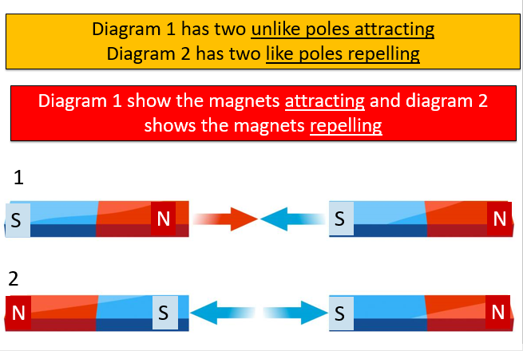
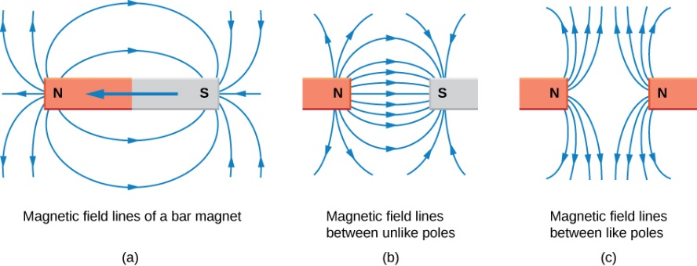
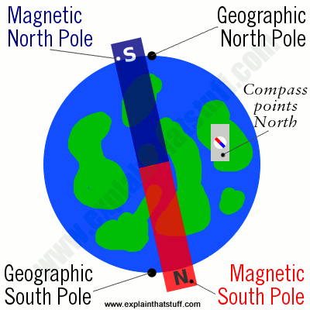
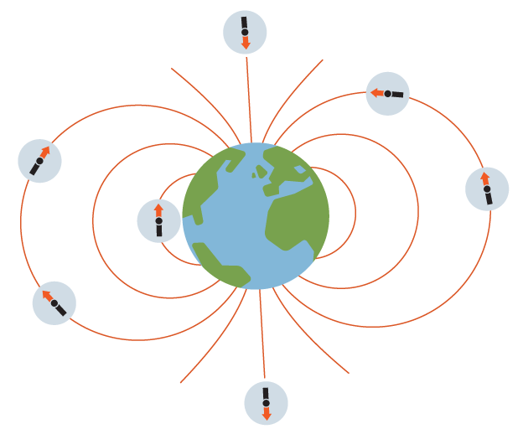
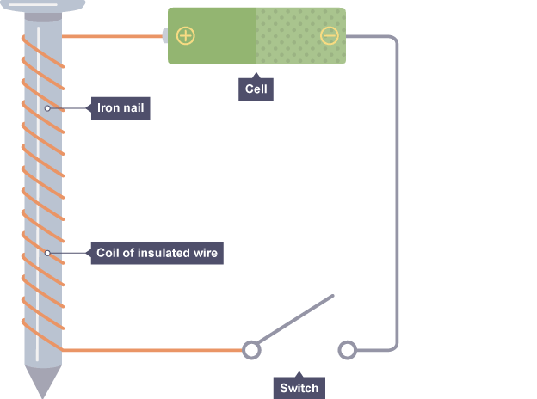
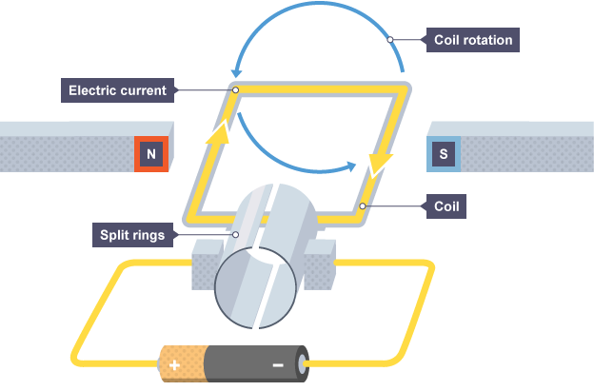

Magnets are made from magnetic metals iron, nickel and cobalt. These are the only pure metals that can be turned into a permanent magnet. Steel is an alloy of iron and so can also be made into a magnet
Year 8 -Physics 2
The poles of a magnet are the places where the magnetic forces are strongest. When two magnets are brought close together they exert a force on each other. Two like poles repel each other. Two unlike poles attract each other.
A permanent magnet always causes a force on other magnets, or on magnetic materials. Key features of a permanent magnet:
it produces its own magnetic field
the magnetic field cannot be turned on and off - it is there all the time
Induced Magnet
An induced magnet is a material that becomes a magnet when it is placed in a magnetic field.
Induced magnetism is a temporary process, when removed from the magnetic field an induced magnet loses most/all of its magnetism quickly.
The region around a magnet where a force acts on another magnet or on a magnetic material (iron, steel, cobalt and nickel) is called the magnetic field.
The force between a magnet and a magnetic material is always one ofattraction.
When an electric current flows in a wire, it creates a magnetic field around the wire. This effect can be used to make an electromagnet. A simple electromagnet comprises a length of wire turned into a coil and connected to a battery or power supply.
You can make an electromagnet stronger by doing these things:
wrapping the coil around a piece of iron (such as an iron nail)
adding more turns to the coil
increasing the current flowing through the coil
The magnetic field lines are closer at the poles which show there is a stronger the magnetic field. The direction always points from the north (seeking) pole of a magnet to the south (seeking) pole.
How to plot the magnetic field pattern of a bar magnet. place a plotting compass near a pole of the magnet and mark the direction that the compass points. Move the compass around the bar magnet marking at intervals the direction the compass points. Join the points up and add an arrow pointing from the north pole to the south pole
Electric motors use the forces produced by magnetic fields interacting to produce a turning motion. If you put a length of wire in a magnetic field and pass a DC current through it (such as from a battery), the wire will move. This is called the motor effect.
The Earth behaves as if it contains a giant magnet. It produces a magnetic field in which the field lines are most concentrated at the poles. A compass comprises a magnetic needle mounted on a pivot (so it can turn freely) and a dial to show the direction. The north pole (north-seeking pole) of the compass needle points towards the Earth’s north pole, which is actually the magnetic south pole. This can allow people to navigate.
The speed of the motor can be increased by:
increasing the strength of the magnetic field
increasing the current flowing through the coil

