Slide 1
Year 8 – Physics 4
Prior Learning
KS3 – Transverse waves and longitudinal waves.
KS2 – Sounds are caused by vibrations which travel to the ear, sound is fainter further away.
Keywords:
Speed
Sound
Longitudinal wave
Echo
energy
Medium
Vibrations
Compressions
Rarefaction
Vacuum
Reflected
Frequency
Pitch
Volume
Amplitude
Ear drum
Cochlea
Ultrasound
Ossicles
Speed
Distance
time.
Auditory nerve
Big Idea:
The total amount of energy in the Universe is always the same, but it can be transferred from one energy store to another.
Oracy:
Earphones sound be permanently banned for under 18s.
P4.1a - Research the hearing ranges of 5 different species of animals. | P4.2a - Make a homemade instrument, use your science knowledge to describe how it works. | P4.3a - Explain how whales communicate over long distances using whale songs.
P4.1b - Describe the difference between loudness and pitch. Use labelled diagrams to aid this description. | P4.2b - Explain how 'mosquito alarms' deter unwanted teenagers from areas. Write an argument for or against the use of ‘mosquito alarms’. | P4.3b -The intercom has stopped working and two astronauts need to get a message to each other while they are repairing the outside of their space station. Compose a text message you could send to them to explain how they can hear each other without the intercom, explaining the science behind it. You should use the particle model to help you explain.
P4.1c - Take any empty glass, fill to the very top with water. Tap the top with a metal spoon. Note the pitch of sound, remove 100 ml of water and repeat process and note the pitch of the sound. Keep removing water until there is none left. Present your results in a table. | P4.2c - Using two hard plastic cups poke a small hole in the bottom and thread 10cm of the end of a 3metre piece of string through each hole. Secure with a knot. Talk into your cup, can you hear through the homemade phone? Experiment with different string lengths, volumes, and can types to see how the pitch and/or clarity compares. Write a report with a method and your results. | P4.3a - 1)Find a wall that reflects sound.. 2)Measure a distance of at least 50 m from the wall. 3)Clap your hands in time to the echo from the wall. 4) Clap your hands 11 times while recording time with the stopwatch. 5) Multiply the distance by 10. 6) Divide the distance the sound traveled by the amount of time it took to clap. 7) Write a report with a method, diagram and results.
Future Content
KS4 – ultrasound and speed of sound
Extended project

Slide 2
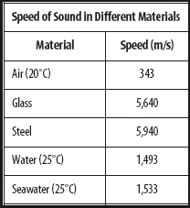
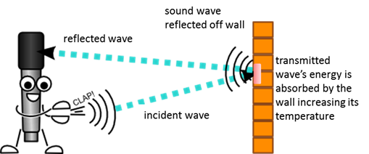
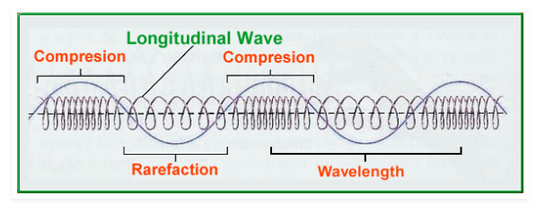
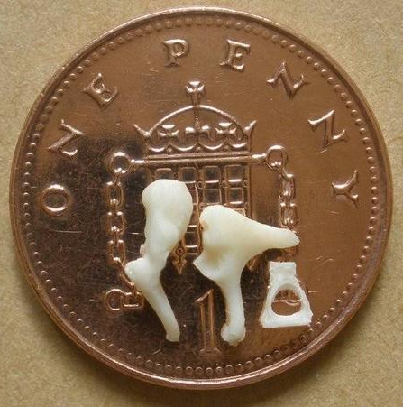
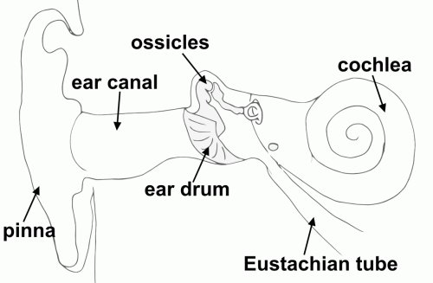
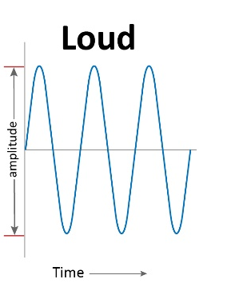
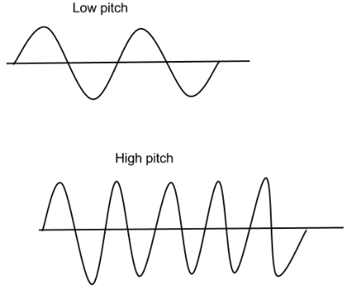

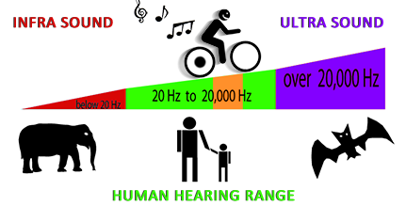
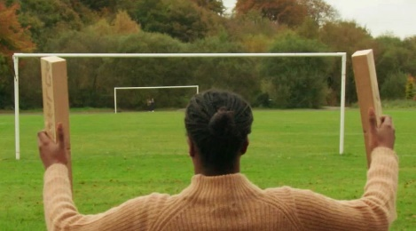
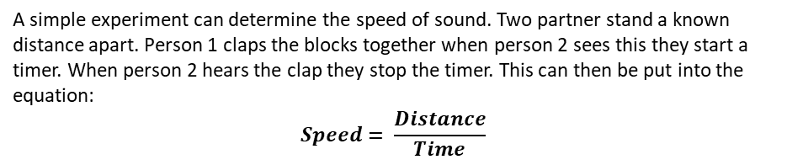
Sound is a Longitudinal wave. In longitudinal waves the energy and the medium move in the same direction. Longitudinal waves cannot travel through a vacuum.
Compressions – Area were particles are closer together.
Rarefaction – Area were particles are further apart.
Sound waves can be reflected, causing a Echo. Hard, smooth surfaces works best.
The speed of sound changes in different mediums. Sound can travel faster in solids than in liquids or gases because particles can collide with each other more easily.
Volume is decided by the amplitude (from peak to the middle) of the wave.
Pitch is decided by the frequency (number of waves per second) of the wave.
Sound waves travel up the ear canal to the ear drum, the sound waves causes the ear drum to vibrate passing the vibrations to three small bones known as the ossicles, these amplify the sound and send it through the middle ear to the cochlea. The cochlea is lined with tiny hairs which detect the sound causing an electrical signal which is sent to the brain by the auditory nerve.
A simple experiment can determine the speed of sound. Two partner stand a known distance apart. Person 1 claps the blocks together when person 2 sees this they start a timer. When person 2 hears the clap they stop the timer. This can then be put into the equation:
$$Speed= \frac{Distance}{Time}$$

