Slide 1
Prior Learning: Classification and characteristics of living things- animals and plants, life cycles and basic requirements for life, fossils as evidence of change over time, recognise variation between individuals
Yr 7 – Fundamentals of Biology
Extended project: Drawing Cells
Oracy: If your parent is a top athlete, you should become a top athlete
Big Idea 5: All organisms are made of cells and all cells respire
Big Idea 6: Genetic information (DNA) is passed down from one generation to another.
FB 1a Research the invention of the microscope and summarise the key developments as a timeline on a poster that could be displayed around the science department. Use scientists' names, dates when the discoveries were made and include pictures where possible to make your poster interesting. | FB 2a Write a poem, song or rap about inheritance and the different types of variation within the human population. You must include at least these key words and what they mean: species, variation, continuous, discontinuous, gene, chromosome. | FB 3a Who was Gregor Mendel? Who was Rosalind Franklin? Who were Watson and Crick? Produce an information card for each scientist including their key information and the work they did.
FB 1b Research and explain the working and function of electron microscopes | FB 2b Construct a timeline showing the key steps in scientists' understanding of DNA. You should start at 1953 when Watson and Crick first produced the model of DNA, up to the present day. You can include pictures and diagrams to make your timeline interesting to look at, but don't lose sight of the important scientific information! | FB 3b Half-fill two glasses with warm water. Stir three tablespoons of salt into one of them. Carefully cut the ends off two carrots and stand one in each glass. Leave them overnight then take them out of the glasses and dry them off. What has happened to them? Explain why you have observed these changes, using key scientific words.
FB 1c Explain, in detail, the link between the development of microscopes and the level of scientific understanding that we have. (As microscopes have got better, what discoveries have been made?) | FB 2c Build a model cell using materials you can find at home. Your model needs to be accompanied by an information sheet which contains a picture of the cell you've modelled and explains: What type of cell it is, where it would be found, what its function is and what each material you've used for the model represents, including why you chose it. e.g. this green skittle represents a chloroplast because it's green like chlorophyll and is a similar shape to a chloroplast. | FB 3c You work for a company that makes stink bombs. A toy shop is interested in selling your stink bombs but wants to know how they work and what safety advice is on the packaging. Using ideas about diffusion, write a letter of reply to the toy shop, explaining simply how a stink bomb smell spreads, making sure you refer to the reasons behind your safety advice.
Keywords:
Eyepiece
Stage
Nucleus
Cytoplasm
Cell membrane
Structure
Function
Adaptation
Vacuole
Chloroplasts
Mitochondria
Respiration
Cells
Tissues
Organs
Organ system
Organism
Diffusion
Gametes
Sperm
Egg
Fertilisation
Dominant
Recessive
Future Content: KS3 Biology 1 Respiration and digestive systems KS4 Cell Biology Cell structure specialised cells, transport across membranes
KS3 Biology 2 Reproduction KS4 Organisation Respiration and digestive systems

Slide 2
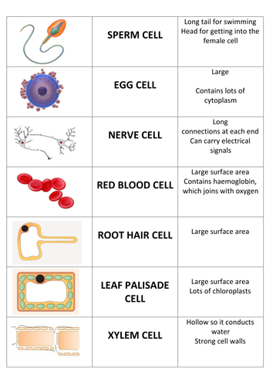
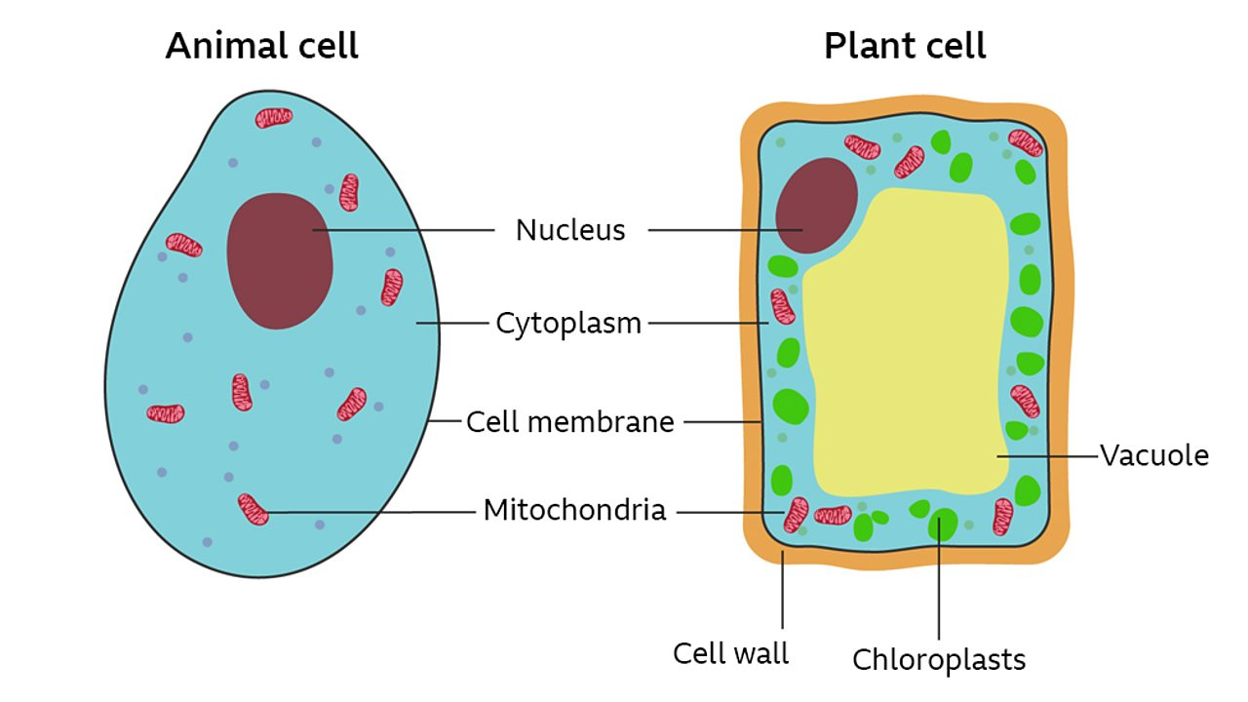
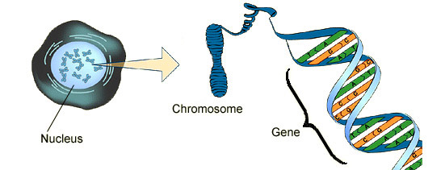
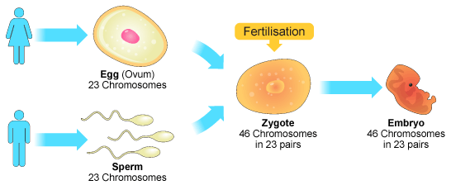
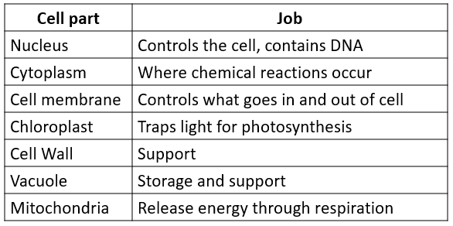
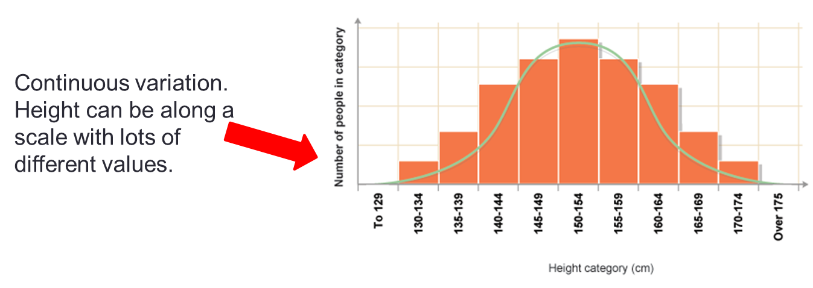
Content
We are all different, partly due to the environment we grow up in and partly due to our genes.
Genes are found on our DNA in every cell in our body. They are a set of instructions.
We inherit our genes from our parents.
We call the differences in a species variation. Variation can be continuous (eg height) or discontinuous (eg blood group)
Diffusion is the movement of particles from a high concentration to a low concentration.
A group of similar cells working together is called a tissue.
Tissues working together are called organs.
Organs working together are called organ systems.
Organ systems working together make up an organism.
This cell has a higher concentration of oxygen outside the cell…
…so oxygen will diffuse in to the cell
Graphs showing continuous variation look like this
Graphs showing discontinuous variation look like this

