Slide 1
Year 7 - Chemistry 1
Oracy:
You are the main hazard in the lab.
Catalytic converters add unnecessary cost to car manufacturers.
Keywords:
Chemical reaction
Reactant
Product
Periodic table
Atom
Element
Mixture
Compound
Metal
Non-metal
Particle
Attraction
Ion
Electron
Solution
Dissolves
Saturated solution
Word equation
Combustion
Thermal decomposition
Endothermic
Exothermic
Catalyst
Collision
Energy
Limewater
Chemical symbols
Carbon dioxide (CO₂)
Oxygen (O₂)
Water (H₂O)
Copper Carbonate (CuCO₃)
Magnesium (Mg)
Prior Learning
Particles, burning and combustion, atomic structure, conservation of mass, acid and alkalis, neutralisation, diffusion, distillation, chromatography.
Big Idea:
All matter in the universe is made of tiny particles called atoms and how they behave depends on their structure.
Home learning tasks
C1.1a Key words and definitions Your teacher will give you 3 – 6 key words from this topic. You need to find the definition and learn them (including spelling) for a review test. | C1.2a Dalton’s Atomic Model Work out key words, write and identify chemical symbols and describe physical properties (see worksheet) | C1.3a Research an element in the periodic table. What is its symbol? Where did it’s name originate from? What are its properties and uses.
C1.1b Match up the key words and definitions (see worksheet) A cut and stick revision exercise to check your understanding | C1.2b Modelling particles Make models out of materials at home to show the difference between the key terms element, compound and mixture | C1.3b The history of gunpowder Literacy task with questions including numeracy. (see worksheet)
C1.1c Elementary Explain what atoms are & match ements with their chemical symbols. (see woksheet) | C1.2c Video https://www.youtube.com/watch?v=DVGaNxEM7M8 Watch the video and describe the thermal decomposition of iron sulfate using words and pictures, | C1.3c Oil Leak (see worksheet)) Working scientifically skills including calculating means, drawing a scatter graph,, interpreting the graph and drawing conclusions
Future Content:
Year 9 Atomic Structure and Periodic Table
The atom, symbols, relative atomic mass, electronic charge, isotopes, ionic bonding and ionic compounds and the periodic table.
Extended project:
Using key words to describe chemical reactions

Slide 2
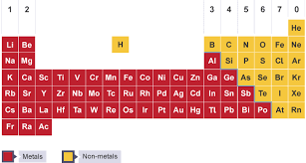
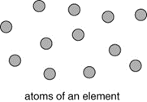
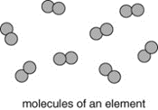
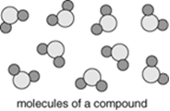
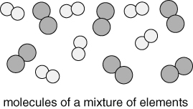
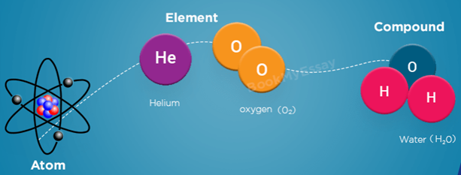
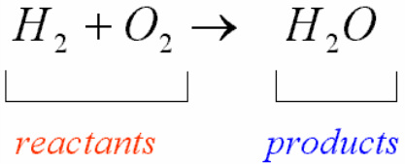
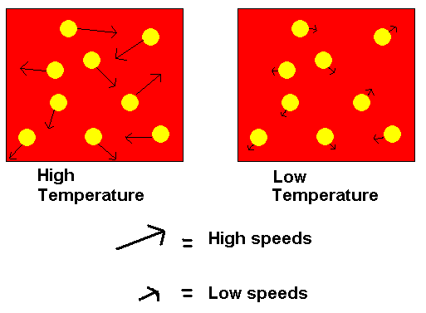
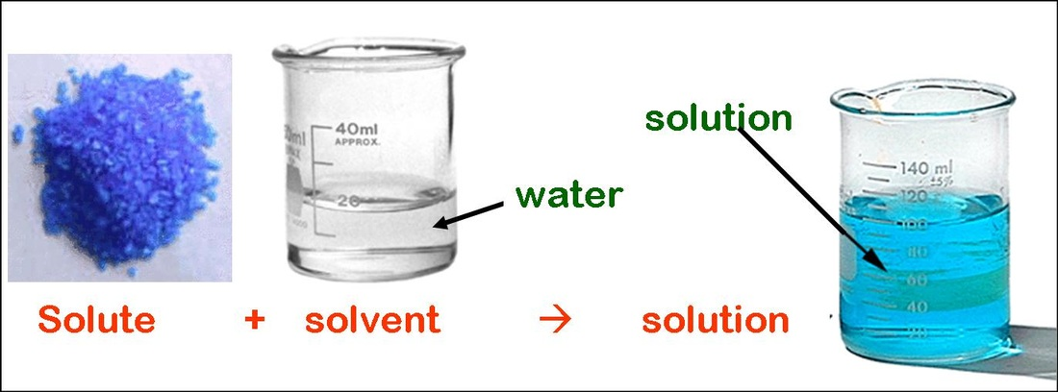
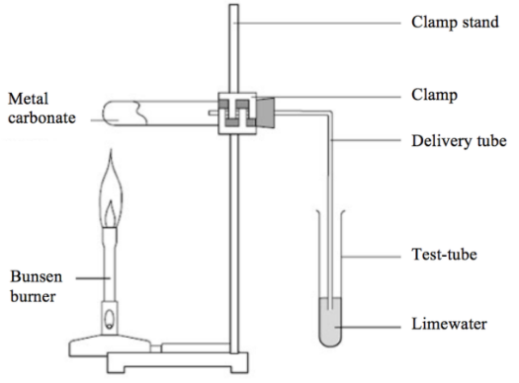
Element = ‘Pure’ only contains one type of atom
Compound = two or more different atoms chemically bonded together
Mixture = substance that contains different molecules not joined
Typical signs of chemical reaction:
a colour change,
a gas being given off
a solid forming in a liquid,
an energy change
Chemical reaction = One or more new substances are formed
2H₂ + O₂ → 2H₂O
The periodic table lists all 118 known elements. Element are described by symbols of one or two letters.
The first letter is always a capital letter and the second is always lower case.
The same symbols are used in all countries.
Naming compounds
If there is a metal in the compound, the name of the metal goes first.
If the compound contains only two elements then one of the element’s name has its ending changed to ‘ide’.
e.g. zinc + oxygen = zinc oxide
iron + bromine = iron bromide
If the compound contains three elements, including oxygen and carbon the name of the metal is followed by “carbonate”.
e.g. sodium + carbon + oxygen = sodium carbonate
Thermal decomposition A compound is broken down into simpler substances by heat.

