Slide 1
Prior Learning: Biology 1: Balanced diet and respiration, heart rate and exercise
Yr 8 - Biology 4
Extended project: Research project and presentation on over the counter medicines.
Big Idea 5: All organisms are made of cells, and all cells respire.
Oracy: All athletes should be allowed to take performance enhancing drugs
B4 1a Compose a newspaper article explaining the issues that arise due to binge drinking. Discuss the short-term and long-term effects. Add data to support your argument. | B4 2a Write or type the alphabet down the page. For each letter, identify a word or phrase related to this topic. E.g. Addiction is …………. | B4 3a Write 3 tweets that would encourage young people to avoid the use of (i) smoking (ii) alcohol (iii) cannabis. Tweets can only be 140 characters. They must use key words and be informative.
B4 1b Draw a diagram of the brain showing what each part does. Shade the parts of the brain which would be affected by alcohol use. | B4 2b Write a poem/song/rap about the negative effects of taking illegal, recreational drugs. | B4 3b Find an online reaction timer. Test your reactions and write down your time. Repeat 9 more times then work out your average reaction time. Drink a can of coke (or something else with caffeine) and repeat. Did you see a difference? Write a conclusion for your results.
B4 1c Annotate a picture of the human body to show how smoking affects it. You must label the organs and describe the effects. | B4 2c Design a poster to describe the effects of smoking has on an unborn baby. You need to consider the following ideas: birth weight, brain development and oxygen availability. | B4 3c Write at least two paragraphs on the safety of vaping. Make sure you reference any online resources you use. Is it better than smoking cigarettes?
Keywords:
Drug
Stimulant
Depressant
Addiction
Withdrawal
Tolerance
Alcohol
Tar
Nicotine
Carbon monoxide
Bronchitis
Cancer
Emphysema
Cannabis
Heroin Performance enhancing
Future Content: KS4 Biology Infection and Response, Organisation Testing drugs, painkillers, antibiotics, effect of lifestyle on non-communicable diseases

Slide 2
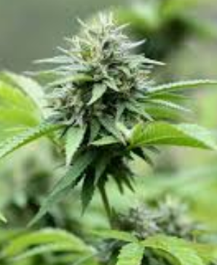
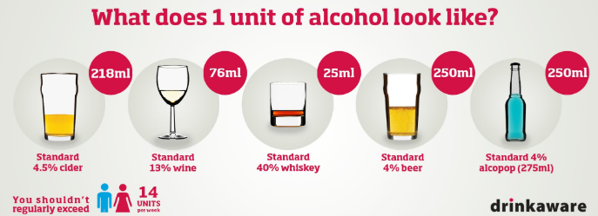
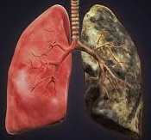
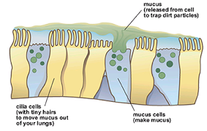
Content:
Drug: A drug is a substance which changes the chemical reactions of the body.
Stimulants increase brain activity eg) caffeine and cocaine. Depressants slow down the nervous system eg) alcohol and heroin.
Addiction: This is when a person’s body craves a drug. If they try to stop taking the drug, they may have withdrawal symptoms.
Alcohol is a depressant which can lead to damage to the liver, heart, brain and kidneys as well as causing cancer.
Cannabis is a recreational drug which can cause mental health issues. However, it can be beneficial as a treatment for epilepsy.
A person can develop tolerance to a drug which means they have to use higher amounts to get the same effect. This may lead to overdose.
The main chemicals in cigarette smoke are tar, nicotine and carbon monoxide. Nicotine is the drug which causes addiction. Carbon monoxide lowers the amount of oxygen the red blood cells can carry.
Performance enhancing drugs are drugs taken to make someone better at a sport. These are banned and athletes get tested for them, but it can be hard to control.
Tar becomes trapped in the mucus in the lungs and stops the cilia from working correctly. This can lead to irritation of the bronchioles and bronchitis. Damage to the alveoli means less oxygen can be taken in.

