Slide 1
Prior Learning:
- Fundamentals of Biology .
YEAR 7 – Biology 2.1
Oracy: Life begins at conception
Keywords:
Adolescent
Adult
Amnion
Anther
Baby
Birth
Conception
Egg
External fertilisation
Female
Filament
Foetus
Gamete
Gestation
Growth spurt
Internal fertilisation
Male
Menstrual Cycle
Ovary
Oviduct
Ovule
Pistil
Placenta
pollen
Pollination
Puberty
Sexual reproduction.
Sperm
Sperm duct
Stamen
Stigma
Style
Teenager
Testes
Toddler
Big Idea:
Number 6 – Genetic information (DNA) is passed down from one generation to another (lessons 1 – 6).
Home Learning
Bio 2.1 – The Egg and The Sperm. Draw and label simple diagrams of both the egg and the sperm cells, state where each are produced. Then explain where the genetic information is stored in each. (links to Biology 2 lesson 1 and Fundamentals of Biology) | Bio 2.2 – Puberty. Everyone goes through puberty at different times and speeds. Write a letter to somebody from a different part of the country that may be going through puberty explaining to them what to expect and why they should not to be worried. (links to lesson 2) | Bio 2.3 – A Baby!! We all started our development after the same process called fertilisation. Research the main stages of a foetus’ development and pregnancy. Present your work in any way that can be handed to your teacher. (links to lesson 3)
Bio 2.4 – Boy or a Girl? State the most common way that a baby is checked on while still inside the mother. Explain why this way is used the most (include positives, negatives and any other common ways you might find during your research). (links to lesson 4) | Bio 2.5 – A baby was born… Draw a flow diagram that clearly tells us the stages of giving birth. Optional You may want to also state why a mother may need help. (links to lesson 4) | Bio 2.6 – Plants go though reproduction? State the male and female gametes of a plant. Using pictures (or words if you don’t like drawing) show some ways that plants may become pollinated. (links to lesson 5)
Bio 2.7 – The perfect seed. Design with explained drawings a perfect seed that would ensure that it has the best chance of growing into a beautiful plant. (links to lesson 6) | Bio 2.8 – The story of a plant. Create an illustrated story of the plant life cycle from fertilisation → seed →growth (young plant to adult plant)→ and back to fertilisation. (links to lessons 5 and 6) | Bio 2.9 - Is it real? Create a plant – you can make this out of any materials you are allowed to use at home. You should be able to explain the parts of your plant using some of the key words so you might want to write a notes sheet for your creation as well. (links to lessons 5 and 6)
Future Content: KS4
Extended project –

Slide 2
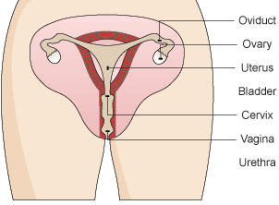
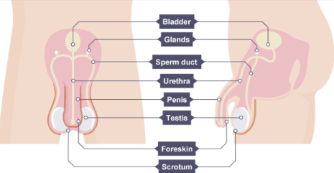
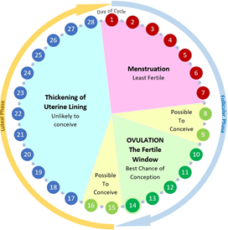
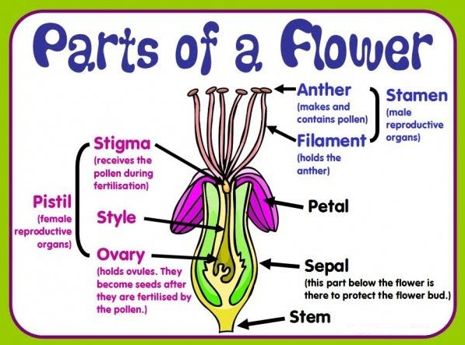
Human Female Reproductive system:
Ovaries: Contains undeveloped female gametes (egg cell).
Oviducts: Connects Ovaries to the uterus.
Uterus: Also known as the womb, where a baby develops until birth.
Cervix: Muscle in the uterus, helps keep the baby in place during pregnancy.
Vagina: Muscular tube that goes from the outside of the female body to the cervix.
Human Male Reproductive system:
- Testes: Produces males gametes (sperm cell) and hormones.
Glands: Produces nutrient rich fluids for sperm.
Sperm Ducts: Carries sperm to be mixed with nutrient rich fluids from the glands – semen is created.
Penis: (contains urethra) Passes urine and semen out of the male body.
Urethra: Tube that urine and semen pass through.
Puberty – Time in which sexual maturity happens.
Male
Male and Female
Female
Voice breaks (gets deeper).
Testes and penis get bigger.
Shoulders get wider.
Hair grows from face and chest.
Underarm hair growth.
Pubic hair growth.
Body smell get stronger.
Emotional changes.
Growth rate increase.
Breasts develop.
Ovaries start to release egg cells (menstrual cycle starts.
Hips get wider.
Reproduction of plants.
After fertilisation the female parts of a plant develop into that plants fruit.
This fruit will carry the seeds. Seeds are made up for three main parts to allow for plant growth:
The Embryo – the young root and shoot that will develop into the adult plant.
A food store – made up of starch so that the seed has energy until it can perform photosynthesis.
Seed coating – protects the seed with a tough outer coat.
Step 1 – pollen is transported from one plant to the stigma of another (pollination).
Day 17-28: If the egg is not met and fertilised by a sperm and the uterus lining continues to thicken until the cycle restarts.
If fertilisation takes place, the egg attaches to the lining, the woman becomes pregnant and menstruation does not happen.
Pollination can happen by either insects or the wind depending on the type of plant.
Step 2 – For fertilisation to take place the pollen from a plant needs to land on the stigma of another plant of the same species.
Day 1 – 7: Menstruation/having a period can take 5 to 7 days. Caused by loss of uterus lining.
Day 8 – 16: Lining of uterus begins to regrow and egg cell starts to mature in one of the ovaries.
Once the egg has matured it is released, traveling through the oviduct towards the uterus.
A pollen tube grows through the flower until it reaches the ovary. The nucleus of the pollen grain (male plant gamete) then joins with the nucleus of an ovule (female plant gamete).
(May be bright to attract insects.)

